Slide 1

Gas Distribution System -Siddharth nalavade

Slide 2
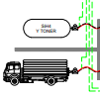
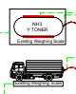
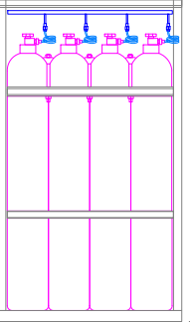
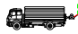

Slide 3
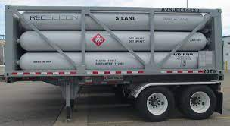

Slide 4
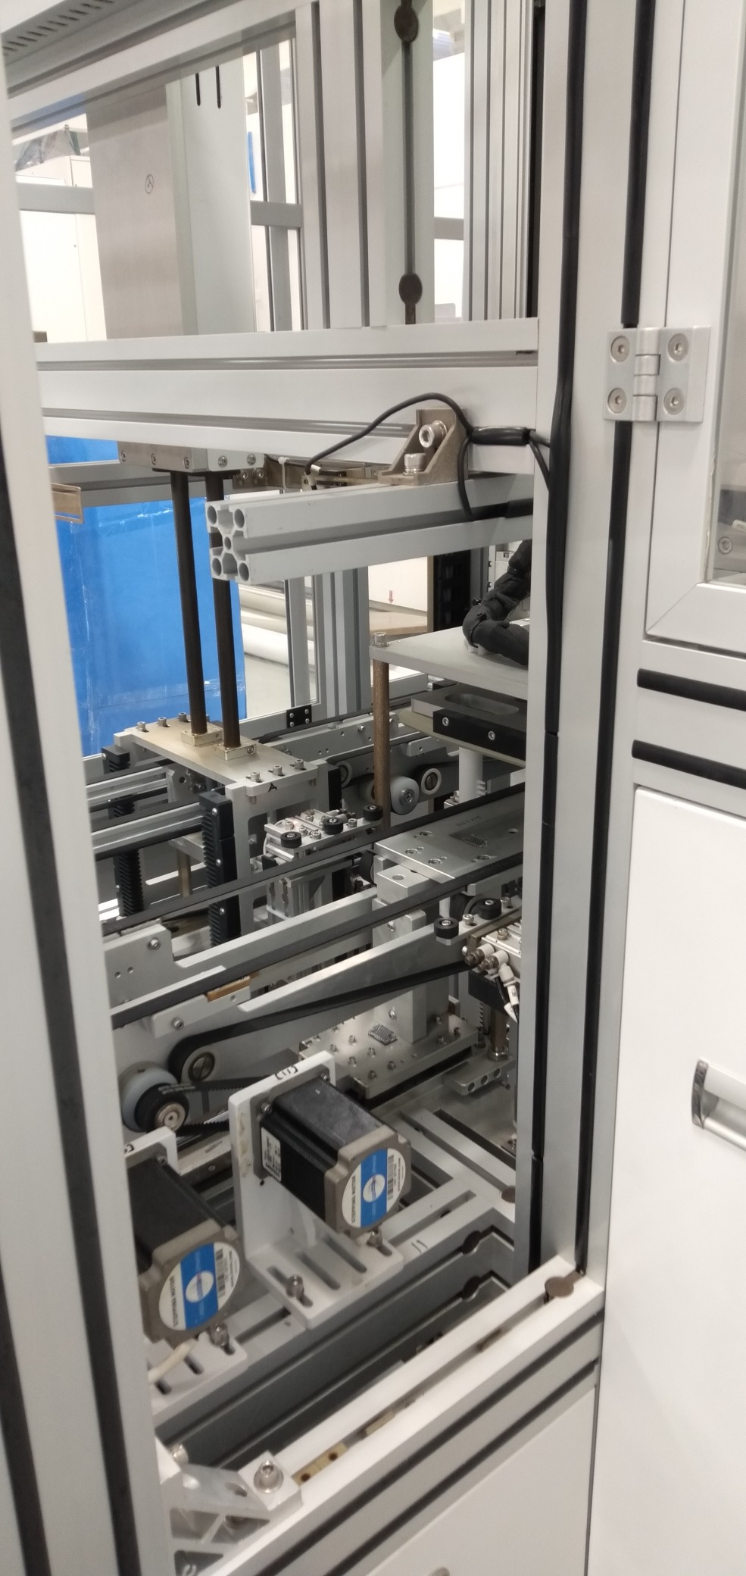
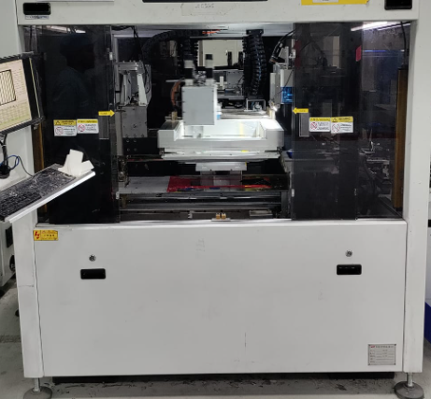
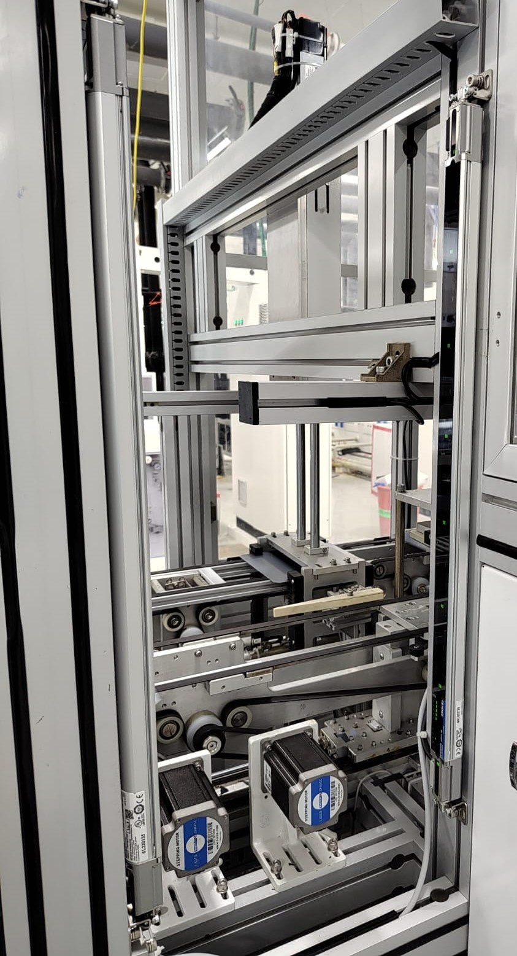
PROCESS TO CHANGE X AXIS LINER RAIL
REMOVE THE ACRYLIC COVE
REMOVE THE METAL SHEET

Slide 5
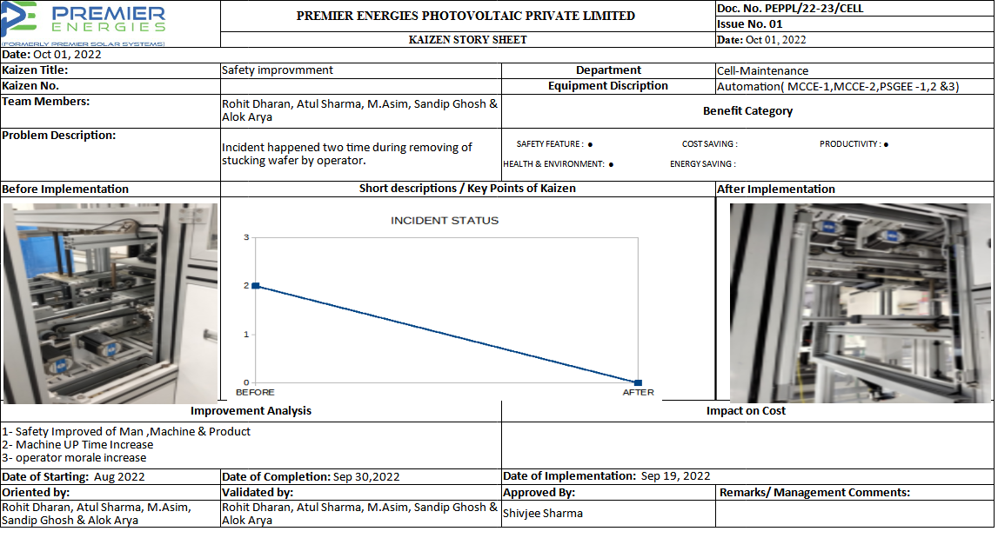
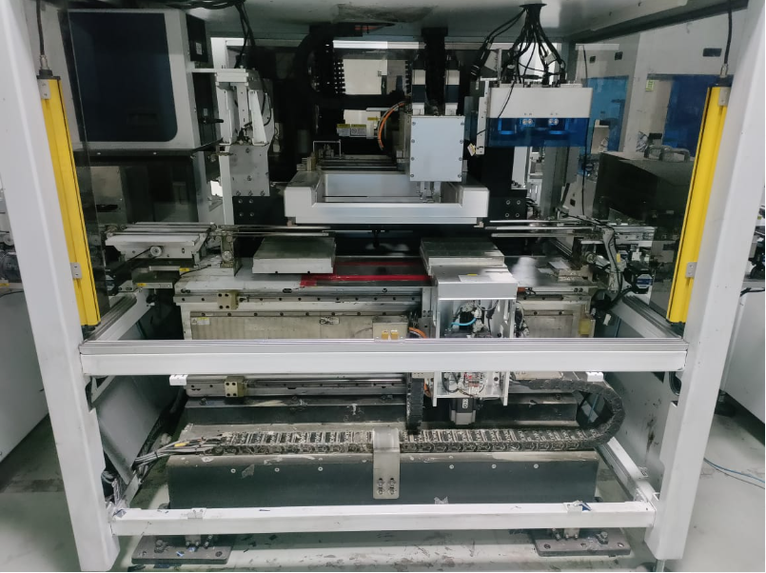
REMOVE THE THIS UNIT

Slide 6
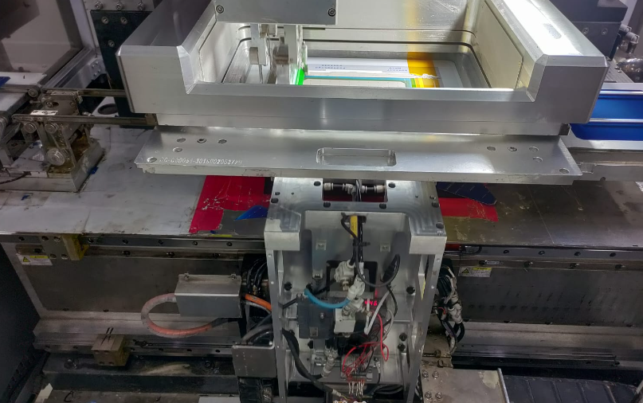
REMOVE STOPPER
REMOVE PNEUMATIC PIPE
REMOVE TERMINAL CABLE

Slide 7
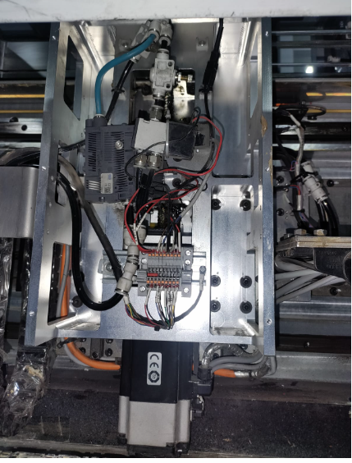
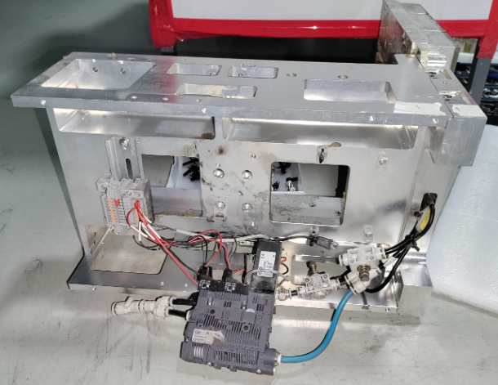
REMOVE TABLE Z AXIS ASSEMBLY
KEEP VACCUM GENERATOR SAFELY
REMOVE THIS UNIT BOLT INDICATED IN CIRCLE

Slide 8
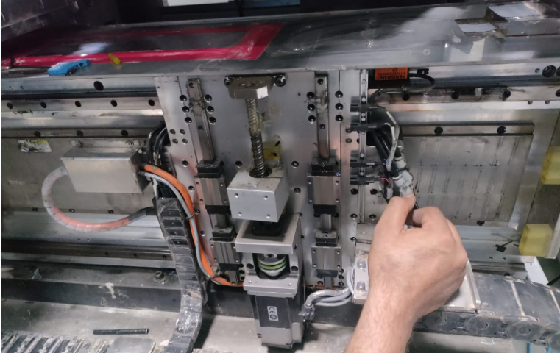
REMOVE Z AXIS RAIL UNIT

Slide 9
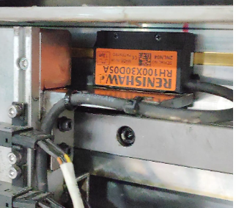
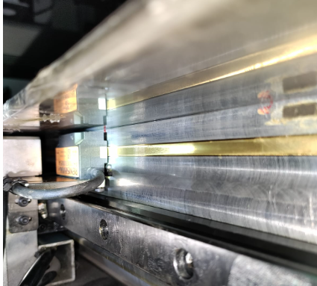
REMOVE ENCODER BRK
KEEP THE ENCODER SAFELY IN COVER
NOTE :WHLILE INSTALLATION THE ENCODER KEEP 2MM CAP

Slide 10
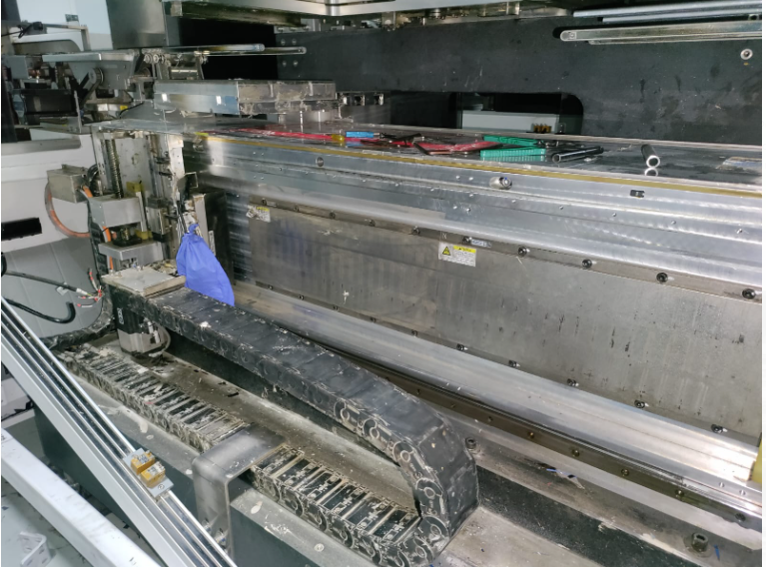
REMOVE RAIL BOLT HOLD END BOLT
PULL THIS UNIT AT END

Slide 11
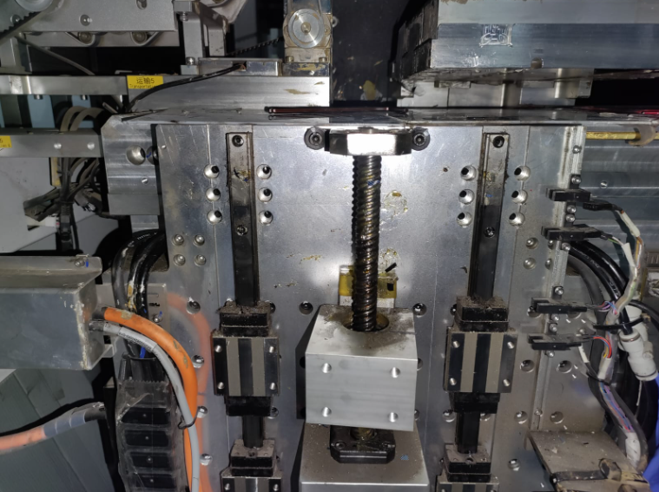
REMOVE BEARING UNIT BOLT

Slide 12
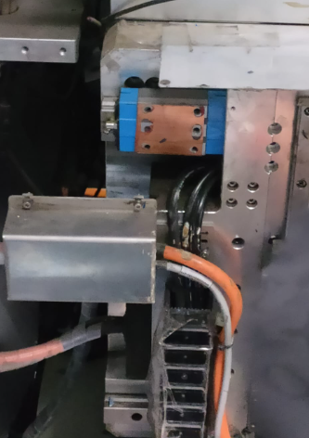
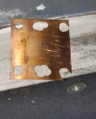
WHILE REMOVING THE BEARING KEEP SHIM SAFELY IF PRESENT
TIP:KEEP GEASE ON BEARING TO HOLD SHIM

Slide 13
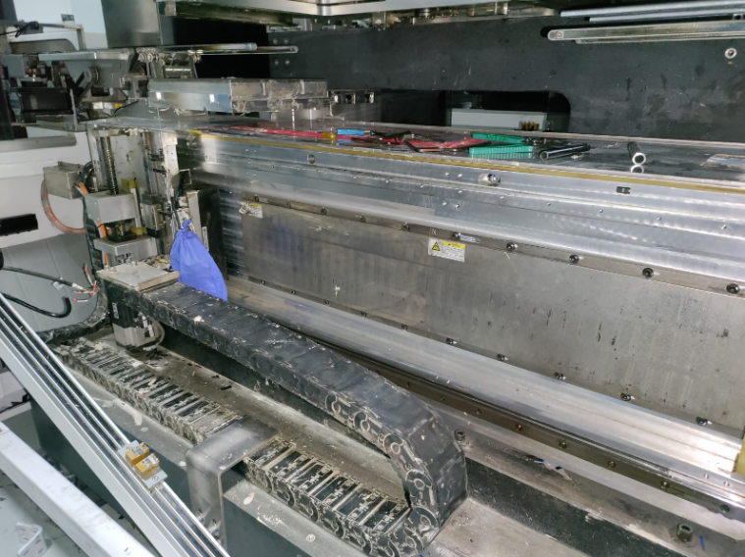
REMOVE ONE RAIL AND REPLACE
NOTE :WHILE REPLACE THE RAIL KEEP IN MIND DON’T TOUCH THE MAGNET

Slide 14
AFTER THE INSTALLATION OF THE RAIL FOLLOW VICE-VERSA

Slide 15
BENEFITS
SAFETY IMPROVED OF MAN, MACHINE & PRODUCT
INCREASE MACHINE UP TIME
OPERATOR MORALE INCREASE

Slide 16
Thank you

